Slide 1
Meteorology 2020: Severe Storms
JHU Science Olympiad Workshop
Anand Gnanadesikan

Slide 2
Some useful resources
Ahrens Meteorology Today (available used)
National Hurricane Center website
https://www.nhc.noaa.gov/outreach/

Slide 3
General slide on study events
Read the rules
Build a binder
For each concept in the list of concepts, write down a paragraph or so of information/include pictures.
You may, or may not be allowed to use the binder in the test… but the process of building it will give you a huge amount of information.
Do not simply download and print out material.
Use the binder to generate tests for themselves.
Coaches major role- accountability, helping understand concepts.

Slide 4
What is pressure?
L
What is the time T between collisions?
T=2L/v
So every T seconds,
the left-hand wall changes the velocity of the molecule by 2v
Imagine we have a molecule bouncing
back and forth between two plates a distance L apart at speed v.
dv=2*v

Slide 5
So on average
Force=mass*acceleration
Force=m(2v/T)=m*(2*v)/(2*L/v)=mv²
But this is just twice the kinetic energy in one direction–
Force from one molecule=k_{B}T/L

Slide 6
If now in each unit of area A…
We have N molecules: Average force is N*k_{B}*T/(L*A)=(N/V)*k_{B}*T
p=nk_{B}T
Ideal gas law!
Pressure is force/area
Number density

Slide 7
Note one implication
For light molecules (like He)
v is large
T=2L/v is smaller
Frequency at which air impacts walls is higher.
Why your voice goes up when you inhale He.
Imagine we have a molecule bouncing
back and forth between two plates a distance L apart at speed v.

Slide 8
Current pressure over North America

Slide 9
How do I get a dimple in the middle of this cup?
Earth is spinning
Imagine you have a cup of coffee that you stir- what does the surface look like?
Why is this?

Slide 10
Answer- it takes a force to make things go in a circle
If we look down on our coffee cup…
The velocity of a parcel of coffee (black arrows) changes as it moves around the cup.
If we have a low pressure in the center of the cup..
This generates the required force (red arrows).
Result is that instead of pressure driving a convergent flow to the center, it drives a “jet” around the central low
Low

Slide 11
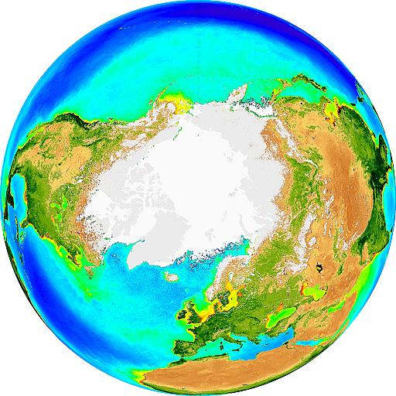
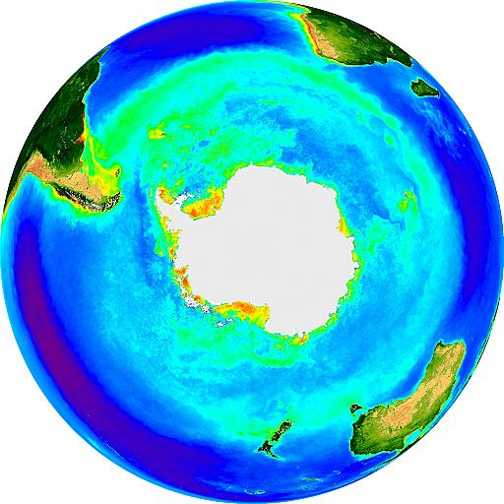
If we look down on the earth from above the pole which way does it spin?

Slide 12
Similarly…
Low pressure systems are spinning faster than the earth underneath them…pressure provides extra centripetal force.
High pressure systems are spinning slower than the earth underneath them, pressure allows this to happen by slowing down acceleration otherwise provided by gravity.
But direction of earth’s spin is opposite in each hemisphere- so low pressure systems spin counterclockwise in northern hemisphere and clockwise in Southern Hemisphere.

Slide 13
Another way of thinking about this
A parcel which is at rest with respect to the earth on the equator has high eastward momentum (m*v) and thus high angular momentum (m*v*r)
If I push a parcel to lower latitudes (via say a pressure force) it has excess momentum and so curves to the right. (in the left in the Southern Hemisphere).
This explains why there are jet streams, and in turn why weather in the mid-latitudes tends to move from west to east (eastward or westerly) .
L
H
H

Slide 14
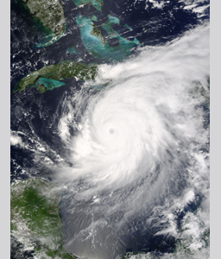
How do we know this is a hurricane?
Location- it’s a strong convective system over the Caribbean
Organization, it’s relatively symmetric
3. Presence of an “eye” (warm core- this is the key to distinguishing tropical cyclones from extratropical ones).
Hurricane Ivan, 2004
Special case of a general phenomenon known as a tropical cyclone

Slide 15
Coriolis and pressure force demo
Needed elements: Lazy Susan, pan, small nail, tape, plastic bottle(s).
Pierce plastic bottle at two levels, cover holes with tape, fill with water, cap.
Place bottle(s) on Lazy Susan, remove tape from both holes
Note which direction the stream takes.
As Lazy Susan turns, note deflection of stream.

Slide 16
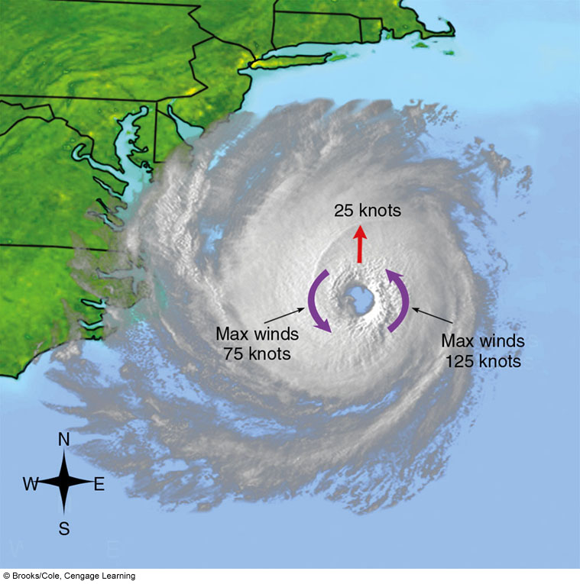
Wind speed distribution
Depends on speed at which center moves as well as central pressure.
Highest winds in Atlantic hurricanes found to right of the center of motion.

Slide 17
Basic principle
On a rotating planet, if you push on some it will eventually tend to move at right angles to the direction in which you push it
In northern hemisphere it will tend to move to the right.
In Southern Hemisphere it will tend to move to the left.
Only along the equator do things move in the direction in which you push them.

Slide 18
A cyclone is approaching Darwin, Australia from the north
In which quadrant are the highest waves?
Northeast
Northwest
Southeast
Southwest
Answer is southeast- to the left of the direction of motion as we are in the Southern Hemisphere.

Slide 19
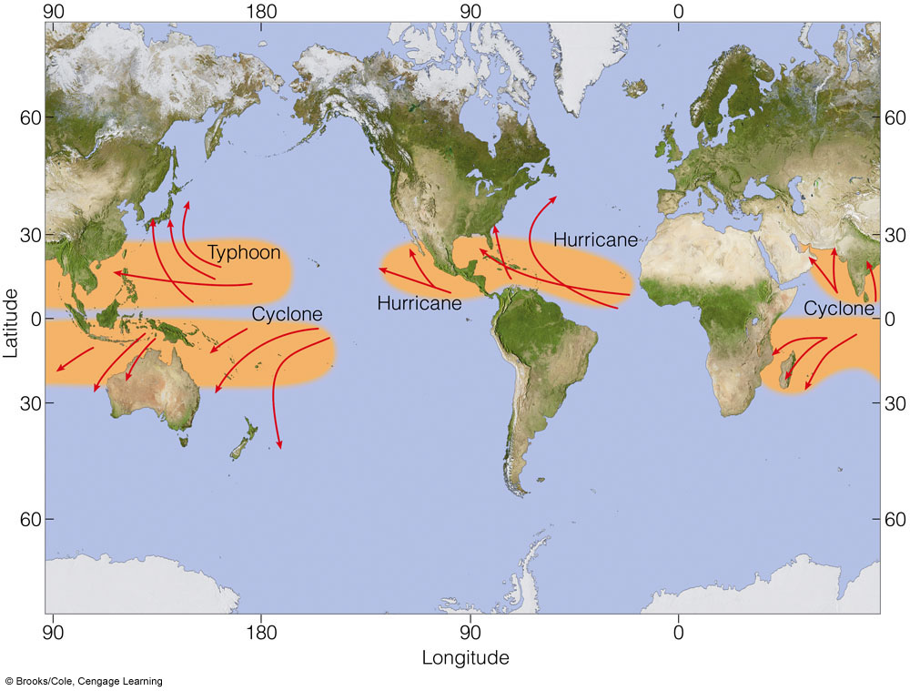
Distribution of tropical cyclones
North Atlantic, NE Pacific Hurricane (Carib god)
Northwest Pacific Typhoon (Japanese fr. Chinese fr. Arabic fr Greek strong wind?)
Rest of world Cyclone (fr. Greek, coil)

Slide 20
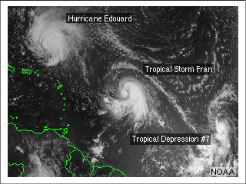
Definition of tropical cyclones
Tropical disturbance: Convective region 100-300km across, convection maintained for more than 24 hours.
Tropical depression: Tropical disturbance with a closed circulation, winds less than 17 m/s (33 knots, 38 mph, “Gale force”) Denoted by number.
Tropical storm: Winds between 17 and 33 m/s (38-74 mph). At this point storm gets named.
Hurricane/Typhoon/Cyclone: Winds over 33 m/s, 74 mph.

Slide 21
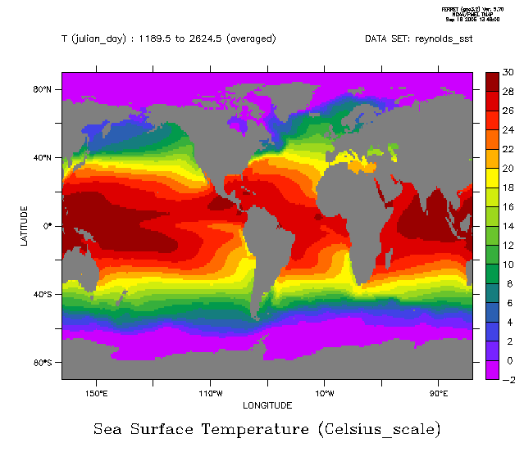
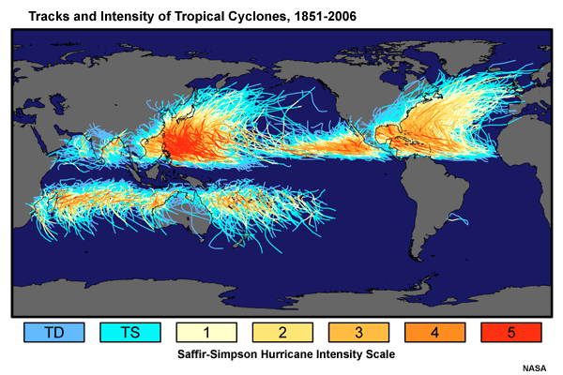
Interbasin distribution of TCs, SSTs
SSTs below 24C seem to suppress cyclone formation…
but cyclone frequency doesn’t track SST in a simple manner.

Slide 22
 | Tropical Storm or stronger (greater than 17 m/s sustained winds)
Basin | Most | Least | Average
Atlantic* | 28 | 4 | 12.1
NE Pacific** | 28 | 8 | 16.6
NW Pacific | 35 | 14 | 26.0
N Indian | 10 | 2 | 4.8
SW Indian | 14 | 4 | 9.3
Aus SE Indian | 16 | 3 | 7.5
Aus SW Pacific | 20 | 4 | 9.9
Globally | 102 | 69 | 86.0
-N. Indian is very warm, but has relatively few tropical cyclones. Why?
-SW Indian is cooler than N. Indian but has more cyclones. Why?
Other questions:
Why is the annual variation from basin to basin so large, but the total variation is relatively small?
Why is there apparently more relative variation in the N. Atlantic than in any other basin?
http://www.aoml.noaa.gov/hrd/tcfaq/E10.html

